Slide 1
GANZ Presentation: Self Disclosure
Notes:
Acknowledgment of Country.
GANZ.
Audience for making time to participate tonight.
Introduce me. A little from you- what drew you to this conversation tonight? What do you want from being here could I hear a few voices around that?
Overview of tonight- I’ve got some definitions, information and clinical considerations to present to you. We’re going to organise you into smaller groups so you can discuss and digest that information together through the session. Let's start by moving you briefly into those groups now to say "hello".
BREAK OUT INTO SMALL GROUPS TO BRIEFLY INTRODUCE YOURSELVES AND LET THE GROUP KNOW WHAT YOUR INTEREST IN THIS TOPIC IS (5- mins)

Slide 2
Break out Groups
Introduce yourselves, let each other know a little about where you practice and what your practice is, and share why you came to this discussion tonight.

Slide 3
What do we mean by “self disclosure”?
It goes way beyond what we actually tell our clients. We are actually self-disclosing all the time!
4 different types of self-disclosure:-
Intentional Self Disclosure (ISD)
Intentional verbal or non-verbal disclosure by the T of personal information from outside the session, during a session.
Notes:
What do we mean by "self disclosure"?
There are probably as many different understandings of this term as there are people participating tonight. There are probably also many varying experiences of SD in the room from good, bad to muddling.
As in so much of clinical practice, there are no hard-and fast rights and wrongs around it.
We are self disclosing all the time! How we walk, talk, greet, dress, decorate our practice area, not to mention what information a simple search on the internet might reveal. (Scroll)
There are 4 diff. types of SD:
Intentional SD: (read definition)
Maybe this is the one you thought of first?! We’ll come back to this one in more detail later, as it’s the one that I think deserves the most consideration, but let’s spend a little bit of time thinking about the other categories first.

Slide 4
2. Inevitable self disclosure
Verbal or non-verbal disclosures where there is no possibility of avoiding them:-
Speech (accent/volume/tone/impediment/analogies/metaphors employed)
Ethnicity or surname
Dress
Office décor/location
Information on website
Non-verbal reactions
Silences
Pregnancy
Absences from sessions
Notes:
2. Inevitable SD- (read definition)
Have a think about your therapist- what are all the things you know/assume about them based on the observations and experiences you have had in your sessions with them…many of them never discussed explicitly.
Here's a photo of my practice room...what does it disclose about me?! (2 mins)

Slide 5
3. Accidental self-disclosures
Accidental self disclosures are either:-
a) incidental (unplanned) encounters outside the session;
b) spontaneous, unintentional verbal or non-verbal reactions inside the session; or
c) other occurrences (on line/in the media/circumstance),
that reveal therapist’s personal information to their client.
Notes:
Accidental SD- :
Accidental self disclosures are either:-
a) incidental (unplanned) encounters outside the session;
b) spontaneous, unintentional verbal or non-verbal reactions inside the session; or
c) other occurrences
that reveal the T's personal information to their client.
Examples...
a)bumping into your client in a restaurant, being seen entering a place of worship, at a school event or political rally, or being mentioned in a partner or family member's obituary, all of which would disclose something of your personal information.
Of course, the incidence of some of these ‘chance encounters’ are much more likely in smaller communities of choice/identity and location.
b)"urghhh!" snakes
Ive got some other ripper examples of accidental disclosure to follow

Slide 6
Notes:
have a look at these.
(Pause to give time for audience to start to read)
As you can see from these posts, accidental self-disclosure can occur in many different circumstances. You can also see from these posts that the clients involved had varying reactions to that experience.
Quick poll with a show of hands: have any of you had negative experiences of accidental disclosure as clients? Positive? Neutral?
Have some of you been in experiences like this as Therapists? How did you address it?
Group discussion (5 mins)
My example- taking my son to ER to find my client one of the rostered doctors on duty

Slide 7
4. Immediacy
Intentional, verbal disclosure of Therapist’s experience of here-and-now, intrapersonal information
E.g “My stomach dropped when you said that”
“I notice feelings of sadness as you talk about your sister”
Understood as “presence” in Gestalt dialogic theory and method:
“Presence means authentically being present and communicating fully and unreservedly (subject to clinical discrimination)..(The therapist) is free to voice or otherwise express to the patient what she is experiencing as it relates to the task of therapy and the therapeutic encounter” (Yontef and Fairfield, 2008).
Notes:
Immediacy is intentional, verbal disclosure of T's experience of here-and-now, intrapersonal information- occurring inside the session.
It is dialogic and phenomenological- intrinsic to Gestalt methodology and theory.
Yontef’s writing on Presence in the dialogic approach is some of the best on how immediacy can be understood and used in good GT.
QuickPoll: hands up positive/negative experiences?.

Slide 8
Potential benefits of Immediacy
can create the conditions for greater affect regulation in client
models comfort with expression of feelings
may offer validation (confirmation) of experience
may help bring into awareness, something out-of-awareness
Notes:
Read slide out
validation eg:
"I notice feelings of anger as you describe how carelessly your brother spoke to you"
bring into awareness eg:" I notice a great sorrow in me as you share that story and yet I can see you smiling"

Slide 9
The Neuroscience of Immediacy
“Therapist self-disclosure can..help shift the patient’s ANS out of either parasympathetic shutdown..or sympathetic hyperarousal..toward ventral vagal connection..the social engagement system.” (Quillman, 2011; p.2)
Immediacy uses (Left Hemisphere) language to communicate the T’s (Right Hemisphere) experience of herself and her client.
Notes:
The use of Immediacy has the potential to achieve something that working with explicit content alone cannot: it can make the implicit, explicit, aligning with a central tenet of regulation theory.
(Pause)

Slide 10
Caveats on the use of Immediacy
“Good Gestalt therapy is freedom to do therapy with spontaneity, liveliness and creativity. But it also entails responsibility to know what you are doing” (Yontef, 1993).
Notes:
Caveats: Timing, intention and delivery matter.
TIMING: Be aware Immediacy may feel confusing to a client early in therapy, especially if they have experienced a different modality of therapy before. Quillman (2012) suggests use of immediacy very early in the sessions risks being perceived as pressure for, or a “ request” that the Client SD before they are ready.
In other circumstances, Immediacy could also be construed as the T blaming the Client for making them feel something unpleasant.
INTENTION: Maroda (1998) warns of 4 potentially problematic forms of immediacy
Firstly, seductive disclosures of love or attraction
Secondly, unsolicited feelings of the T’s inadequacy. Using immediacy to relieve T tension and anxiety in a session will rarely go well.
Thirdly, attempting to express intense feelings when the T is feeling dysregulated isn't a good idea
And finally, giving into a sadistic or power-over interaction with a client is not advisable.
(Eg in a cat and mouse like dynamic, where the client has become the “cat”, the client saying “Youre not sure what to make of me right now…you're a little bit frightened of me right now" and the T answers "Yes, that's right") (Scroll)
DELIVERY:
T embodiment/regulation is essential. If the T isn’t connected to their experience in their body, they have no chance of resonating in the client’s. Know thyself and continue to engage in therapy as much as you can through your professional life.
It is essential that the delivery communicates to the client that the T can hold and contain their own emotional and somatic experience so that the Client does not receive a message that the T needs or
expects them to take care of them.
There is a subtle, but perhaps significant difference between saying to a client:
“I feel anxious when you talk about your partner” compared to:
“I’m aware of feelings of anxiety when you talk about your partner”
Pay attention to choice of language:
Yalom talks about the mindful use of language in practicing immediacy:
For example, “I feel distanced/disconnected from you as you share this” might land very differently from “I feel bored”, which may infer that the client is doing something wrong.
As with ISD, which we will move to next, checking for the impact of this form of self disclosure is generally recommended, although, over time, as it becomes more of a “norm” in the therapy, that may not be as important.

Slide 11
Break out group discussion (20 mins)
What has caught your interest around this information so far?
What are five inevitable self disclosures you make as a therapist and how might these be possibly relevant to the work you do with your clients?
Have you got your own example of an accidental self disclosure you experienced as a client that you could briefly describe and how it was addressed in the therapy afterward? Do you see other options as to how it may have been addressed?
How has the use of immediacy been used effectively for you as a client? - can you give an example and identify what the impact was on you?
Have you experienced the use of immediacy in an unhelpful way? Can you identify if there was something about the timing, intention or delivery that influenced that?
Notes:
BREAK OUT GROUPS: SLIDE WITH PROMPTS
Prompts. It would be great if you could all find a way to have some input in the conversation.
Gentle reminder: personal experiences can be helpful, but in the spirit of collegial respect, please de-identify the actors as much as possible
20 MINS
Group discussion afterwards- what were some of the main topics of discussion in your group?

Slide 12
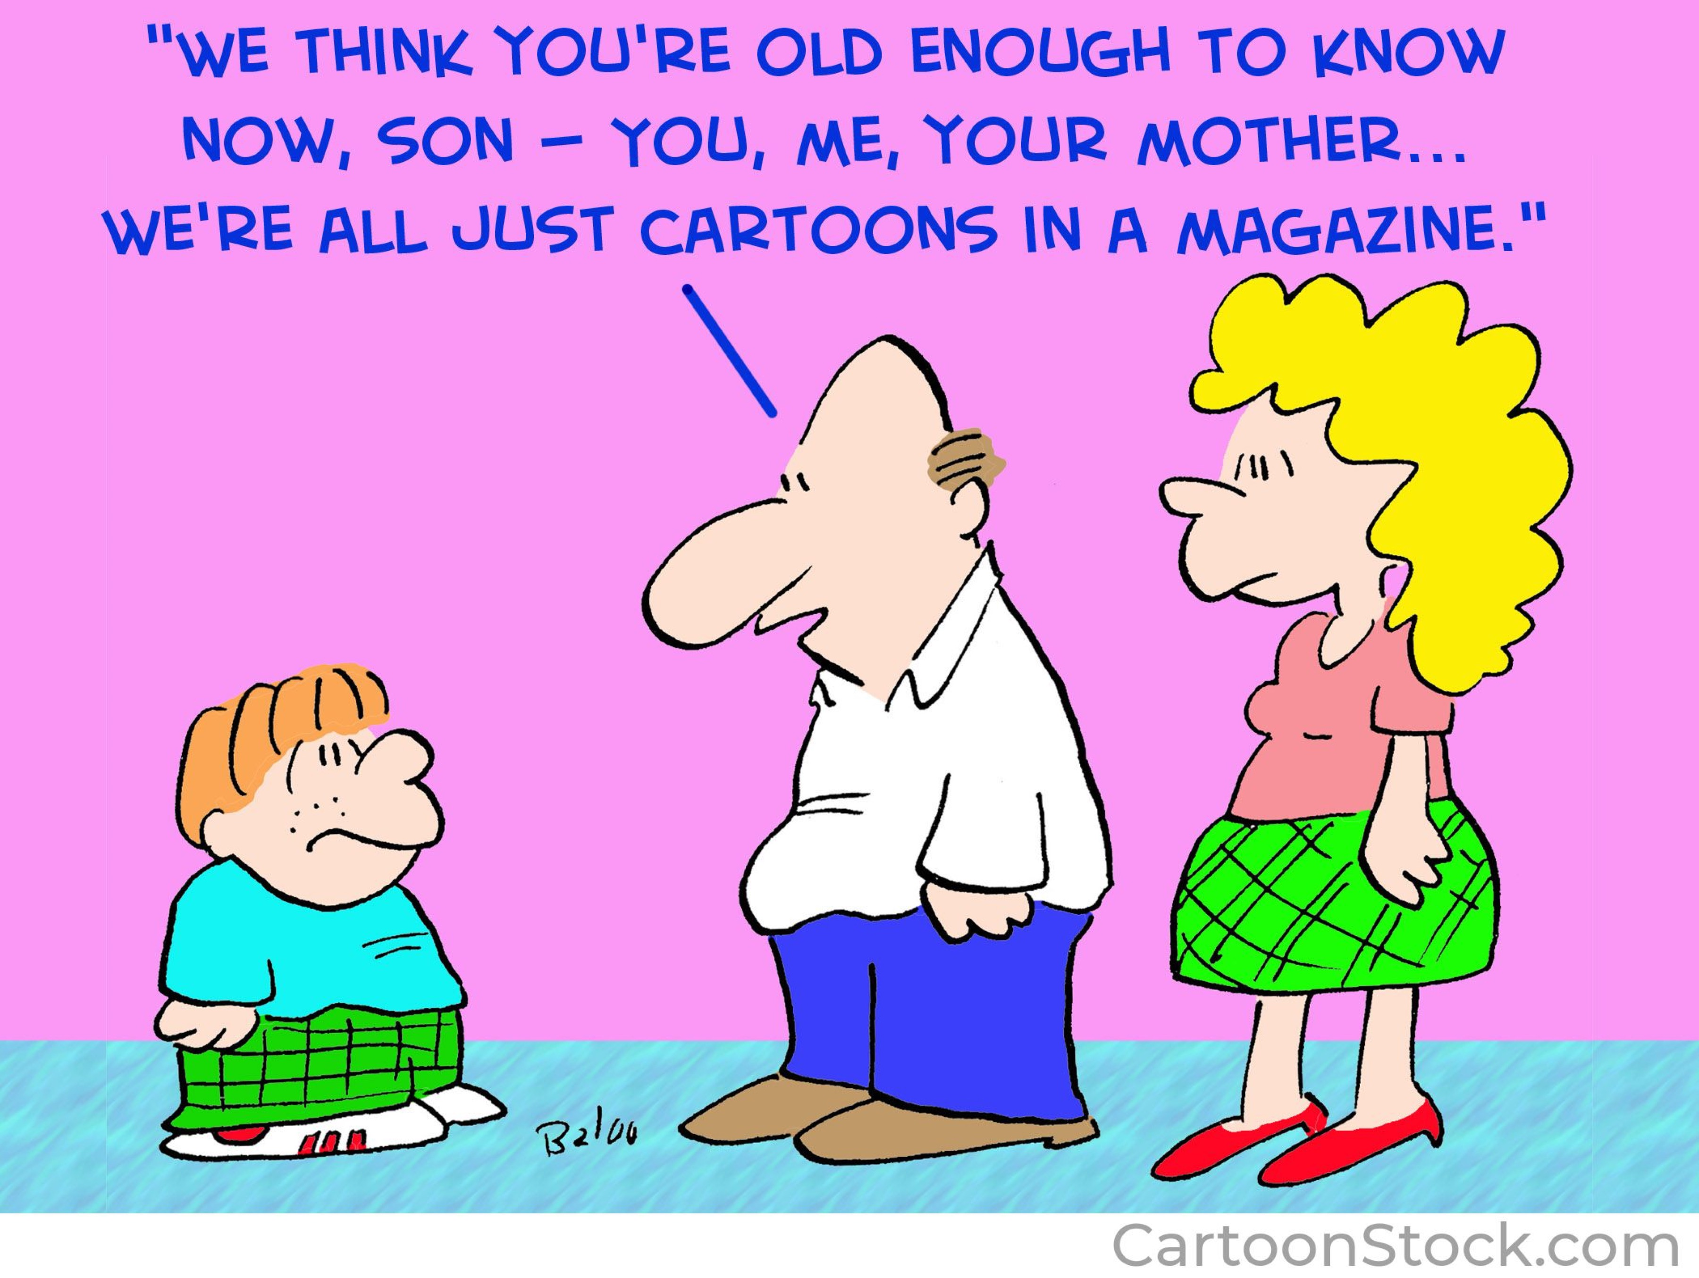
Intentional Self Disclosure (ISD)
Notes:
Intentional Self Disclosure- reminder again here we are discussing
Intentional verbal or non-verbal disclosure by the T of personal information from outside the session, during a session.
-may be client driven for example... or T driven

Slide 13
A brief history…
“..suddenly faced with the knowledge that Freud’s caution to withhold any evidence of our own personalities was not in fact possible, we have been finding ourselves in exciting but often frightening and strange territory.” (Kuchuck, 2009;p.1008)
www.freud.org.uk
Notes:
Brief history: The traditional psychoanalytic view, going right back to the time of Freud was:
-the analyst was the “healthy” expert and the client was the unwell “patient”
-it was believed that the therapist and their environment could provide a “blank” or “neutral” screen upon which the patient would project their transference
Of course, GT was a bit ahead of the game in reacting to and challenging this assumption, but it wasn’t until the 1980’s, with the advent of the Relational Turn, that an overall shift really started to gain momentum. In this decade, sometimes referred to as The Decade of the Brain and catalysed by influences such as :- the innovation of fMRI’s, Daniel Stern’s infant observation research, the rise of intersubjectivity theory and the development of IPNB, we saw a more general shift in psychology from a one-person to a two-person perspective, namely: that the therapeutic encounter was one of co-influence, co-transference and cross-fertilisation between the therapist and client. For some of us, this offered a new “permission” to do what came naturally: the judicious use of intentional self-disclosure as a clinical option.
If we then add to the field conditions social media, politics and popular culture- where intentional self-disclosure by everyone from ex-Prime Ministers and sporting figures to film stars and fourteen-year-olds is pervasive and normalised, it was inevitable that psychotherapists might need to review the question: “to hide or be seen?”

Slide 14
Pros and cons…
Potential benefits:
may be helpful where there is a rupture or therapeutic impasse
may repair /offer a missed developmental or relational experience
may be the most important priority to meet the client in a moment of humanity (Lee and Wheeler speak a lot about “belonging” as an antidote to the isolation of shame)
universality
addressing power differentials
Potential risks:
may be experienced as intrusive
may leave client feeling they have to take care of the T
may take focus away from Client at an inopportune time
Notes:
(pause)
Let's take another quick poll- hands up if you have had a positive experience as a client of ISD? Hands up if you have had a negative experience?
In the literature I read for this presentation, which included some meta-analysis of 21 studies of ISD and its impact on psychotherapy, most authors agreed that ISD is frequently ( 70% of the time in the meta study) enhancing of positive therapeutic outcomes. Seasoned psychotherapy elders like Irvin Yalom and Offir Zur agree.
The literature equally acknowledges that in some circumstances, ISD is contra-indicated and has much to offer in terms of guidelines for its most effective use.
I'm just going to give you a few more moments to digest this slide.
(pause)

Slide 15
Guidelines for effective ISD
Context matters!
“..context is the most important determinant in assessing the appropriateness and ethical valence of self-disclosure” (Gutheil, 2010)
Therapist’s capacity and comfort is relevant- beware disclosing unresolved personal content
If you don’t feel comfortable disclosing, don’t.
Is it in the service of the therapy/relationship? Focus on the Client’s needs, not your own.
Keep it brief!
Ensure it is relevant to the work
Observe the impact of the ISD and enquire about it
If in doubt, stay silent! You can always go away and think about it and return to it.
Notes:
Some tried and tested guidelines:
Context matters- client considerations-culture, relational history, age and the stage of therapy need to be considered.
The T’s capacity to manage the SD intra and interpersonally and to then be able to critically reflect on its effectiveness is also essential . We're all somewhere on the express-inhibit continuum. Congruence, together with capacity to manage the relational impact of your SD are important considerations. It could be argued that a more experienced T will have a greater capacity to do this than a novice Therapist.
Keep it brief- as much as necessary and as little as possible
In cases where the client requests a SD, sometimes first exploring with the client what is behind their request/question can help you determine its relevance and whether your answer would be in the service of the relationship and therapeutic work.
It's critical that you watch and listen for the impact of the ISD. Follow up an ISD with an enquiry like:
"What's it like to hear my answer?" or "What's it like to know this about me?"

Slide 16
tends to be more effective when used in strong, longer term therapies (Pinto-Coelho, Hill, Kearney et.al.; 2018)

Slide 17
A final caveat…
You are bound to keep the client’s confidentiality, they are not bound to keep yours.
Notes:
A final caveat: Confidentiality goes one way- don’t disclose something you are not willing to have shared somewhere else- you can’t ask a client to keep your confidentiality

Slide 18
Break out room discussion (20 mins)
-Share positive and negative experiences of ISD and reflect on why it had that impact on the therapy. Can you imagine where the same ISD may have had the opposite effect (a different client/therapist; different timing; different stage of the work….)?
-what is your own level of comfort with ISD? In what circumstances might that be beneficial to your work as a therapist and where could it create difficulty?
-when was the last time you reflected on an ISD in supervision?
-critically reflect on an ISD you made as a therapist- its effectiveness/not, what supports your assessment and (if it wasn’t effective) what you might do differently if you had your chance again.
-A case study: Client is working on a decision with partner as to whether or not they have children. Client is quite ambivalent about it. Therapist is 50. Therapist has not had children and regrets this. Client asks Therapist: “Have you got children?”.
Notes:
Break out Groups again.
After Break out Groups (if time...)
Any questions or comments arising from that discussion?
Where did the discussion got this time?

Slide 19
Ethics and Self Disclosure
“the question that must be addressed is not whether it is ethical to self-disclose to clients but rather what content, for what reasons, to whom, and under what circumstances should an ethical therapist disclose?” (Peterson, 2002; p.22)
The 3 ethical principles most relevant to SD:-
- For the good of the client (Beneficence)
Do no harm (Nonmaleficence) and
The fiduciary duty the T owes the client: that the relationship is for the benefit and welfare of the client.
Notes:
What are you taking away from the discussion tonight?
Have you got something of what you were wanting from participating?
Could we hear some voices around this?

Slide 20
References
Gutheil, T.G. “Ethical aspects of self disclosure in psychotherapy” (2010). Psychiatric Times (May) 39-41.
Hill, C.E, Knox,S and Pinto-Coelho, K.G “Therapist self disclosure and immediacy: a qualitative meta analysis” (2018). 55(4)Psychotherapy. 445-460.
Pinto-Coelho,K.G, Hill, C.E.,Kearney, Sarno, E.L, Sauber, E.S, Baker, S.M, Brady, J., Ireland, G.W. and Hoffman, M.A. “When in doubt, sit quietly: a qualitative investigation of experienced therapists’ perceptions of self disclosure” (2018) 65 (4) Journal of Counseling Psychology pp 440-452
Kuchuck, S. “Do ask, do tell? Narcisstic need as a determinant of analyst self disclosure”( 2009) 96 (6)Psychoanalytic Review pp. 1007-1024
Yalom, I.D. The gift of therapy: reflections on being a therapist, (2002). Piatkus
Yontef, G.M. Awareness, dialogue and process: essays on Gestalt Therapy; (2009) Gestalt Journal Press.

